Slide 1

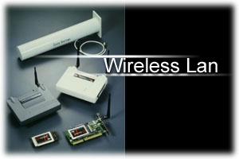
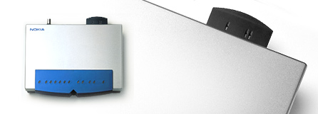
Wireless LAN & IEEE 802.11
An Introduction to the Wi-Fi Technology
Wen-Nung Tsai
tsaiwn@csie.nctu.edu.tw

Slide 2

OUTLINE
Wi-Fi Introduction
IEEE 802.11
IEEE 802.11x difference
WLAN architecture
WLAN transmission technology
WLAN Security and WEP

Slide 3
Wi-Fi Introduction
Wi-Fi 是 Ethernet 相容的無線通信協定
Wi-Fi技術代號是IEEE 802.11，也叫做Wireless LAN
適用範圍在 50 到 150 公尺之間，Transmission rate 可到 11Mbps (802.11b)

Slide 4

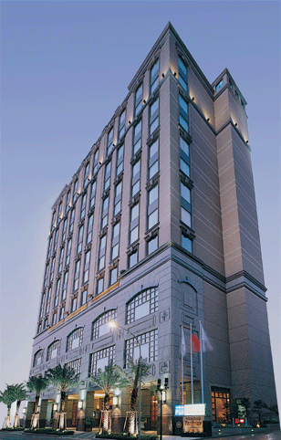



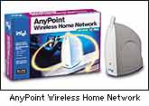

Intended Use
Any Time Any Where
隨時隨地都可上網遨遊
Wireless Internet access inside hotel lobbies, conference rooms, etc.
Wireless with your
Latte?
Wireless home networking ➔ .
⬅ Wireless at the Airport

Slide 5
Wi-Fi Standard (802.11)
Mission: promote 802.11 interoperability as the global wireless LAN standard
Wi-Fi Board members include AMD, Apple, Cisco, Compaq, Dell, Epson, Ericsson, Fujistu, Gateway, HP, IBM, Intel, Microsoft, NEC, Nokia, Nortel, Philips, Samsung, Sharp, Sony, TDK, Toshiba,

Slide 6
Wi-Fi Market in the News
Wireless LAN equipment market
  $969 Million in 2000 to estimated $4.5 Billion in 2006
In 2001:
  Microsoft adds 802.11 in Windows XP
  Major hotel chains install Wi-Fi Internet access
  Around 500 Starbucks stores offer wireless Internet
  Microsoft joins WECA board (the 802.11 alliance)
  Intel Joins WECA board
Most PC/Laptop manufacturers offer Wi-Fi

Slide 7
Wireless Ethernet
Compatibility Alliance (WECA)
Mission statement—WECA’s mission is to
certify interoperability of Wi-Fi™ (IEEE 802.11b) products and to promote Wi-Fi as the global wireless LAN standard across all market segments
Goal—Provide users with a comfort level
for interoperability
Presently over 150 different product certified
and growing

Slide 8
Wireless Growth
“By 2003, 20% of B2B traffic
and 25% of B2C traffic will
be wireless.”
“By 2004 nearly 50% of business applications will be wireless.”
Meta Group Research
Notes:
According to META Group Research, by 2003 wireless and mobile transactions will account for nearly 20 percent of business-to-business traffic and 25 percent of business-to-consumer traffic.

Slide 9
Competing
Short-Range Wireless Technologies
Short-range wireless solutions:
  802.11 (Wi-Fi) family
  Bluetooth
  HomeRF (not as popular)
Who will prevail?
  802.11 more suitable for wireless LANs (office, hotel, airport,…)
  Bluetooth is designed for personal area networks – smart appliances, printers, scanners, etc.

Slide 10
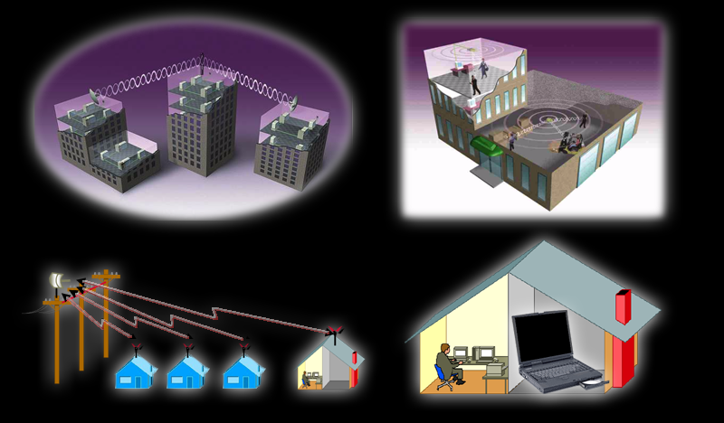
Wireless Standard
*
802.11g
2.4 GHz – OFDM
54Mbps
802.11a Standard
5 GHz – OFDM
54Mbps
Network
Radio
Speed
802.11b Standard
2.4 GHz – DSSS
11Mbps
Proprietary
IEEE 802.11a/b
Ratified
1999
2000
2001
2002
2003

Slide 11
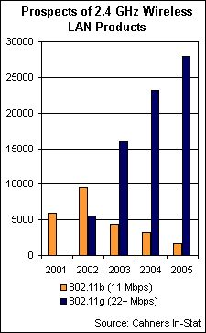
Flavors of 802.11x
802.11 (2 Mbps)
  Older standard
802.11b (11 Mbps)
  Current technology
802.11a (54 Mbps)
  5 GHz (not 2.4 GHz)
802.11g (22~54 Mbps)
  2001/11 draft standard
HiperLAN/2 (European standard, 54 Mbps in 5 GHz band)

Slide 12
Differences between IEEE 802.11?
 | IEEE 802.11 | IEEE 802.11b | IEEE 802.11a | IEEE 802.11g
Frequency | 2.4G Hz | 2.4G Hz | 5 G Hz | 2.4G Hz
Transmission Rate | 1~2 Mbps | 1~11Mbps | 6~54 Mbps | 22~54Mbps
Modulation Technique | FHSS/DSSS | FHSS/DSSS | OFDM | PBCC-22 + CCK-OFDM

Slide 13
Status of IEEE 802.11g
2000/3 - Interoperable w/IEEE 802.11b-1999 and lead to 20+Mbps.
2000/9/21 - TGg first meeting. Function Requirement and Comparison Criteria were adopted.
2001/11 – First Draft issued. Data Rates up to 54Mbps in 2.4GHz band.
2001/12/21 – Draft 1.1.
2002/1 – Enable balloting on the 802.11g standard.
2003/1 – Estimated Final Approval of IEEE 802.11g.
http://grouper.ieee.org/groups/802/11/Reports/tgg_update.htm

Slide 14
Status of IEEE 802.11i
2002/2 – preparing TGi draft
WEP2 – Increases IV spaces to 128Bits.
Kerberos
802.1X
http://grouper.ieee.org/groups/802/11/Reports/tgi_update.htm

Slide 15
IEEE 802 family
802.1 → 高層介面、網路互連
802.2 → 邏輯鏈結控制 (LLC = Logical Link Control )
802.3 → CSMA/CD 乙太網路(Carrier-Sense Multiple Access with Collision Detection)
802.4 → 權杖匯流排 (Token bus) 網路，或稱記號匯流排網路
802.5 → 權杖環 (Token ring) 網路，也有人稱記號環網路
802.6 → 都會網路 (MAN，Metropolitan Area Network)
802.7 → 寬頻區域網路 (Broadband LAN)
802.8 → 光纖區域網路 (Fiber Optic LAN)
802.9 → 多媒體傳輸 (Multimedia traffic)，整合聲音與網路資料
802.10→ 網路保全 (Security)
802.11→ 無線網路 (Wireless Network)
802.12→ 需求優先存取Demand Priority區域網路 (100BaseVG-AnyLAN)
802.14→ 有線電視通訊網
802.1x→ Port Based Network Access Control (Authentication)

Slide 16
IEEE P802 LMSC
http://grouper.ieee.org/groups/802/overview2000.pdf
802.0 | SEC Jim Carlo E-mail: jcarlo@ti.com
802.1 | High Level Interface (HILI) Working Group Tony Jeffree E-mail: tony@jeffree.co.uk
802.2 | Logical Link Control (LLC) Working Group David E. Carlson E-mail: dcarlson@netlabs.net | hibernation
802.3 | CSMA/CD Working Group Geoffrey O. Thompson E-mail: gthompso@nortelnetworks.com
802.4 | Token Bus Working Group Paul Eastman E-mail: paul@rfnetworks.com
802.5 | Token Ring Working Group Bob Love E-mail: rdlove@ieee.org | hibernation
802.6 | Metropolitan Area Network (MAN) Working Group James F. Mollenauer | Hibernation
802.7 | BroadBand Technical Adv. Group (BBTAG) | Hibernation

Slide 17
IEEE P802 LMSC (Cont.)
802.8 | Fiber Optics Technical Adv. Group (FOTAG) J. Paul ’Chip’ Benson, Jr. E-mail: jpbenson@lucent.com | disbanded
802.9 | Integrated Services LAN (ISLAN) Working Group Dhadesugoor R. Vaman E-mail: dvaman@megaxess.com | hibernation
802.10 | Standard for Interoperable LAN Security (SILS) Working Group Kenneth G. Alonge E-mail: alonge_ken@geologics.com | hibernation
802.11 | Wireless LAN (WLAN) Working Group Chairman - Stuart Kerry E-mail: stuart.kerry@philips.com
802.12 | Demand Priority Working Group Pat Thaler E-mail: pat_thaler@agilent.com | hibernation
802.14 | Cable-TV Based Broadband Communication Network Working Group Robert Russell E-mail: rrussell@knology.com | disbanded
802.15 | Wireless Personal Area Network (WPAN) Working Group Chairman - Bob Heile E-mail: bheile@bbn.com
802.16 | Broadband Wireless Access (BBWA) Working Group Chairman - Roger Marks E-mail: r.b.marks@ieee.org

Slide 18
IEEE 802.11 Work Groups
http://grouper.ieee.org/groups/802/11/QuickGuide_IEEE_802_WG_and_Activities.htm
Group | Label | Description | Status
IEEE 802.11 Working Group | WG | The Working Group is comprised of all of the Task Groups together
Task Group | TG | The committee(s) that are tasked by the WG as the author(s) of the Standard or subsequent Amendments
MAC Task Group | MAC | develop one common MAC for Wireless Local Area Networks | IEEE Std. 802.11-1997
PHY Task Group | PHY | three PHY's for Wireless Local Area Networks (WLANs) applications, using Infrared (IR), 2.4 GHz Frequency Hopping Spread Spectrum (FHSS), and 2.4 GHz Direct Sequence Spread Spectrum (DSSS) | IEEE Std. 802.11-1997
Task Group a | TGa | develop a PHY to operate in the newly allocated UNII band | IEEE Std. 802.11a-1999

Slide 19
IEEE 802.11 Work Group(Cont.)
Group | Label | Description | Status
Task Group b | TGb | develop a standard for a higher rate PHY in the 2.4GHz band | IEEE Std. 802.11b-1999
Task Group b-cor1 | TGb-Cor1 | correct deficiencies in the MIB definition of 802.11b | Ongoing
Task Group c | TGc | add a subclause under 2.5 Support of the Internal Sub-Layer Service by specific MAC Procedures to cover bridge operation with IEEE 802.11 MACs | Part of IEEE 802.1D
Task Group d | TGd | define the physical layer requirements | Ongoing
Task Group e | TGe | Enhance the 802.11 Medium Access Control (MAC) to improve and manage Quality of Service, provide classes of service, and enhanced security and authentication mechanisms | Ongoing

Slide 20
IEEE 802.11 Work Group(Cont.)
Group | Label | Description | Status
Task Group f | TGf | develop recommended practices for an Inter-Access Point Protocol (IAPP) which provides the necessary capabilities to achieve multi-vendor Access Point interoperability | Ongoing
Task Group g | TGg | develop a higher speed(s) PHY extension to the 802.11b standard | Ongoing
Task Group h | TGh | Enhance the 802.11 Medium Access Control (MAC) standard and 802.11a High Speed Physical Layer (PHY) in the 5GHz Band | Ongoing
Task Group i | TGi | Enhance the 802.11 Medium Access Control (MAC) to enhance security and authentication mechanisms | Ongoing
Study Group | SG | Investigates the interest of placing something in the Standard

Slide 21
IEEE 802.11
(Wireless Ethernet)
Why can’t we use regular Ethernet for wireless?
  Ethernet: A sees B, B sees C, → A sees C
  Wireless: Hidden node problem
  A sees B, B sees C, yet A does not see C
C
A
B

Slide 22
IEEE 802.11
(Wireless Ethernet) vs. Ethernet
Why can’t we use regular Ethernet for wireless?
  Ethernet: B sees C, C sees D → B & C can’t send together
  Wireless: B can send to A while C sends to D
B
C
A
D

Slide 23
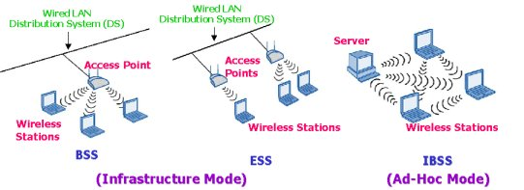
WLAN architecture
Infrastructured wireless LAN
Ad-Hoc LAN
Independent Basic Service Set Network

Slide 24
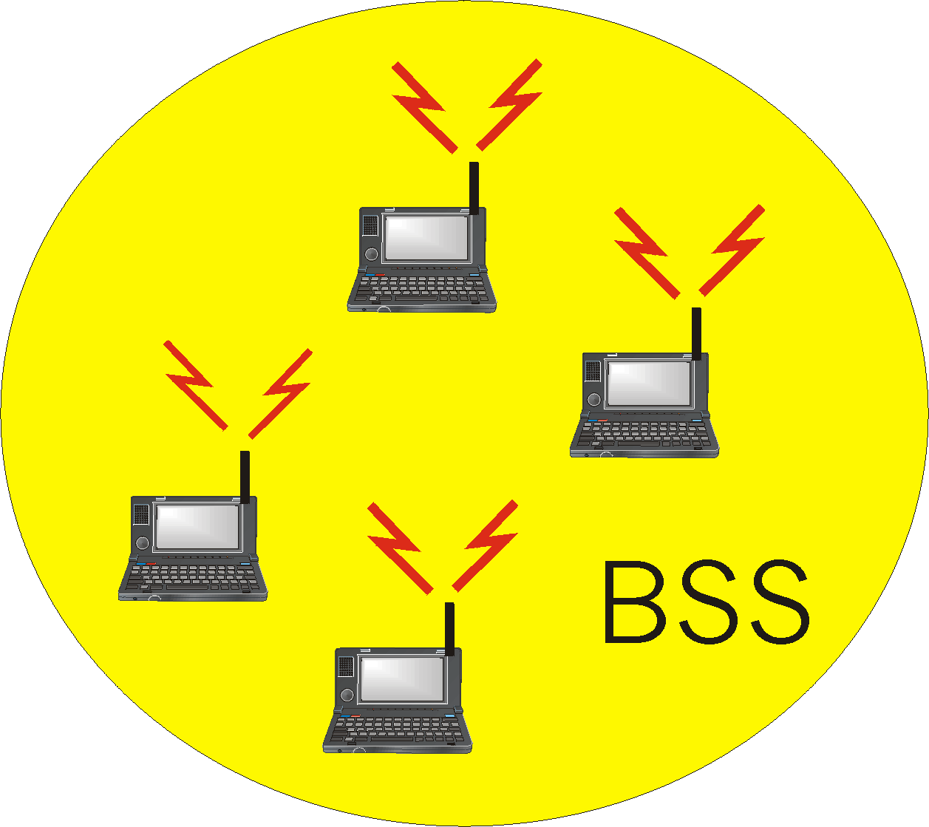
Ad Hoc Wireless Networks
IEEE 802.11 stations can dynamically form a group without AP
Ad Hoc Network: no pre-existing infrastructure
Applications: “laptop” meeting in conference room, car, airport; interconnection of “personal” devices (see bluetooth.com); battelfield; pervasive computing (smart spaces)
IETF MANET
(Mobile Ad hoc NETworks)
working group

Slide 25
Components of 802.11
.
A MAC, PHY layer specification
Should serve mobile and portable devices
  What is mobile?
  What is portable?
Should provide transparency of mobility
Should appear as 802 LAN to LLC (“messy MAC”)
Basic Service Set (BSS)
Distribution System (DS)
Station (STA)
STA that is providing access to Distribution System Service (DSS) is an Access Point (AP)
802.11 supports Ad-hoc networking
Provide “link level security”
BSS (1)
STA 1
(AP)
DS
STA 2
(AP)
BSS (2)

Slide 26
WLAN transmission technology
Microwave (微波)
  主要用於大樓間 LAN 網路連接
Spread Spectrum (展頻)：
  Frequency Hopping Spread Spectrum
  Direct Sequence Spread Spectrum
Infrared ray (紅外線)：
  Difused（散射式,非直線式）
  Directed（直射式）

Slide 27
Industrial, Scientific and Medical (ISM) Bands http://www.fcc.gov/Bureaus/Engineering_Technology/Orders/1997/fcc97005.pdf
5.15 to 5.35GHz (1997/01)
200 MHz, not ISM
902 to 928MHz
2.400 to 2.4835GHz
5.725 to 5.850GHz
26MHz
83.5MHz
125MHz
(For U-NII devices up tp 5.825GHz)
1
2
3
4
5
6
FREQUENCY (GHz)
UNLICENSED OPERATION GOVERNED BY FCC DOCUMENT 15.247, PART 15
SPREAD SPECTRUM ALLOWED TO MINIMIZE INTERFERENCE
2.4GHz ISM BAND
  More Bandwidth to Support Higher Data Rates and Number of Channels
  Available Worldwide
  Good Balance of Equipment Performance and Cost Compared with 5.725GHz Band
  IEEE 802.11 Global WLAN Standard
AP96358 3-4

Slide 28
IEEE 802.11
Physical Layer
  2.4G Hz (5.15-5.35GHz, 5.725-5.825GHz for 802.11a)
  Spread Spectrum
  Frame format
MAC Layer
  CSMA/CA
Security
  Authentication
  WEP

Slide 29
Channel allocation for 802.11b
Ch1: 2.412GHz (2.401GHz ~ 2.423GHz)
Ch2: 2.406GHz ~ 2.428GHz
Ch3: 2.411GHz ~ 2.433GHz
2.416GHz， 2.438GHz
Ch6: 2.426GHz ~ 2.448GHz
2.442， 2.447， 2.452， 2.457，
Ch11: 2.462GHz (2.451GHz ~ 2.473GHz)
歐洲 ~ ch 13, 日本 ~ ch14

Slide 30
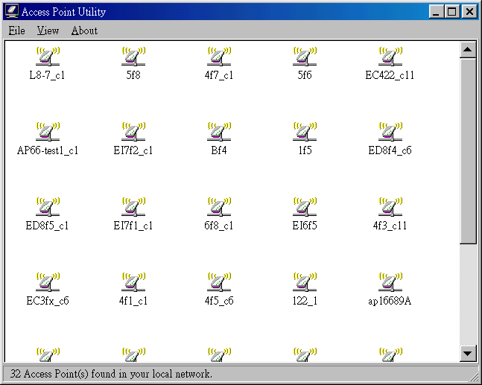
Channel Assignment

Slide 31
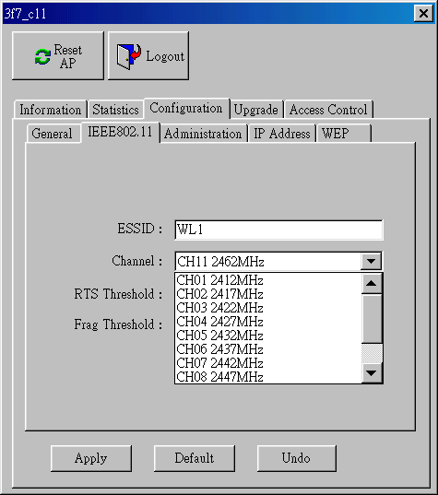
Channel Assignment (cont.)

Slide 32
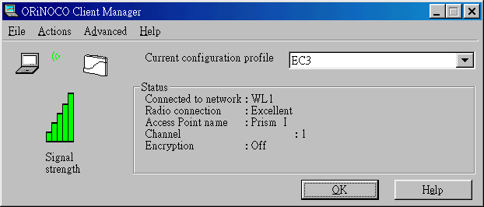
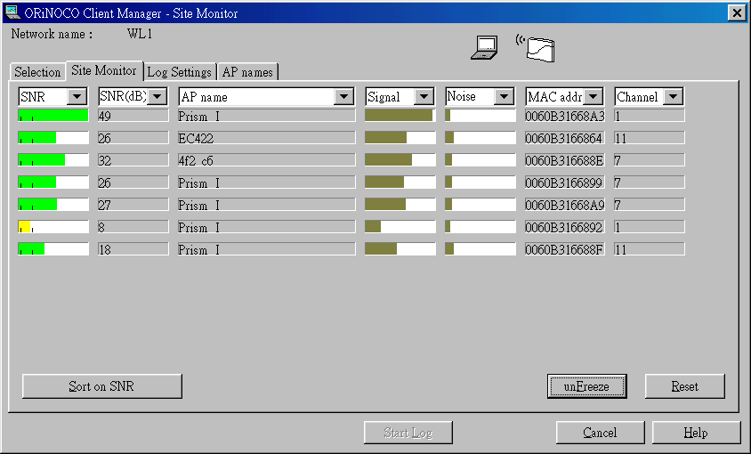

Slide 33
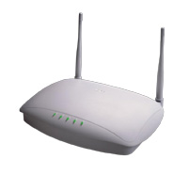
Channel assignment (cont.)
三樓
Ch11
Ch 1
Ch6
二樓
Ch6
Ch11
Ch 1
一樓
Ch 1
Ch6
Ch11

Slide 34
IEEE 802.11 Physical Layer:
Spread Spectrum
Frequency Hopping Spread Spectrum (FHSS)
  The FHSS physical layer has 22 hop patterns to choose from. The frequency hop physical layer is required to hop across the 2.4GHz ISM band covering 79 channels. Each channel occupies 1Mhz of bandwidth and must hop at the minimum rate specified by the regulatory bodies of the intended country. A minimum hop rate of 2.5 hops per second is specified for the United States.
Direct Sequence Spread Spectrum (DSSS)
  The DSSS physical layer uses an 11-bit Barker Sequence to spread the data before it is transmitted. Each bit transmitted is modulated by the 11-bit sequence. This process spreads the RF energy across a wider bandwidth than would be required to transmit the raw data. The processing gain of the system is defined as 10x the log of the ratio of spreading rate (also know as the chip rate) to the data. The receiver despreads the RF input to recover the original data.

Slide 35
Frequency Hopping Spread Spectrum
f5
f4
AMPLITUDE
f3
f2
f1
FREQUENCY
1
2
3
4
5
6
7
8
9
10
11
12
TIME
FSK DATA MODULATION
PERIODIC CHANGES IN THE CARRIER FREQUENCY SPREADS THE SIGNAL
CARRIER FREQUENCY CHANGES AT A SPECIFIED HOP RATE
CARRIER FREQUENCY HOPS AFTER A PRESCRIBED TIME
TOTAL SYSTEM BANDWIDTH INCLUDES ALL OF THE CHANNEL FREQUENCIES USED IN HOPPING
AP96358 2-13

Slide 36
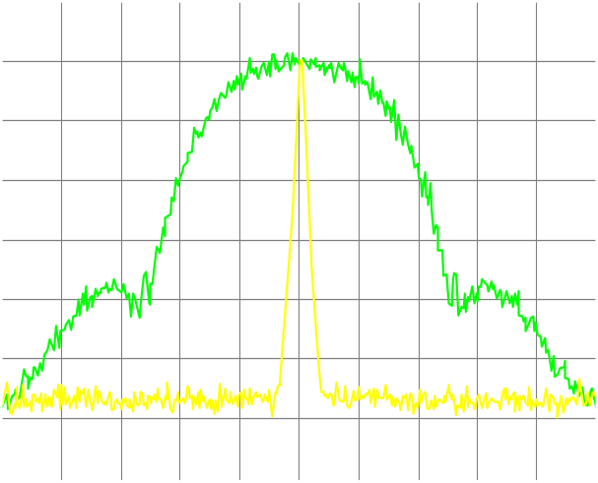
Direct Sequence Spread Spectrum (DSSS)
DATA SIGNAL SPREAD BY A PN CODE
PROPERTIES OF PN CODE
CHIP RATE
DS PROCESSING GAIN
PN CORRELATION AT RECEIVER
PSK DATA MODULATION
CW SIGNAL
AMPLITUDE
(dBm)
SPREAD SIGNAL
AMPLITUDE
(dBm)
18
1.2
15
1.0
CHIP RATE
12
0.8
  G_{P} (dB) = 10LOG (
)
DATA RATE
9
0.6
6
0.4
3
0.2
0
0
1
0
CHIP
CLOCK
2.43
2.44
2.45
2.46
2.47
DATA
FREQUENCY (MHz)
BARKER
CODE
SPREAD
DATA
AP96358 2-11

Slide 37
FHSS vs. DSSS in 802.11
 | FHSS | DSSS
頻寬bandwidth | 1M HZ | 83.5 MHZ(2.400G-2.4835 G Hz)
傳輸transmission | 1~2M bps | 1~11M bps
距離 | 10~20公尺 | 20~150公尺
被干擾性 | 不易 | 易
成本 | 低 | 高
材料使用彈性 | 大 | 小
應用 | 802.11 | 802.11/802.11b

Slide 38
DSSS in 802.11b
雖然在802.11定義了跳頻展頻(FHSS)、直序展頻(DSSS)窄頻微波、紅外線等傳輸方式，但是在802.11b中僅僅定義了直序展頻(DSSS)，也因此直序展頻成了目前所有廠商的標準。同時最高傳輸速率由802.11的2Mbps提高到11Mbps，使用的頻道在2.4~2.4835GHz
同時為了向下相容早期802.11所定義的1~2Mbps的傳輸速率，因此802.11b實際上可以4種不同的傳輸速率。
傳輸速率(Mbps) | 調變方式
1 | BPSK
2 | QPSK
5.5 | CCK
11 | Complementary Code Keying (cck)
藍芽使用 高斯頻率鍵控移位(gaussian frequency shift keying；GFSK)
資料來源：IEEE

Slide 39
DSSS in 802.11b
無線電通訊系統是利用正弦波的三個特性：振幅(amplitude)、頻率(frequency)和相位(phase)。這三個特性代表的意義分別是：訊號有多大(聲)、訊號移動的有多快、它位於正弦波上哪一個位置。
相位調變被廣泛地應用在數位通訊系統上，例如：802.11標準。相位鍵控移位(PSK)的「鍵控」通訊協定所產生的序列(sequence)，就是用來決定調變訊號的相位變化，以傳輸數據。我們常看到BPSK(Binary PSK)、QPSK(Quadrature PSK)、和M-PSK或M-ary PSK(M是符號狀態數目。若符號數目是n，則M=2n。
BPSK是二進位制相位鍵控移位，具有兩個符號狀態(symbol states)；QPSK是象限相位鍵控移位，具有四個符號狀態；M-PSK是多階(multilevel)相位鍵控移位，符號狀態數由M值決定，M值越大通訊效果越佳。

Slide 40
IEEE 802.11 Physical Layer：
Frame format
Immediate
Sender (AP3)
Intermediate
Destination
(AP1)
Ultimate
Destination (E)
Source
(A)
Control
Duration
Addr1
Addr2
Addr3
Control
Addr4
Data
CRC
Distribution System
Frame Type (RTS,CTS,…)
ToDS
FromDS
A
E
RTS: Request-to-Send
CTS: Clear-to-Send
AP1
F
AP3
C
AP2
D
B

Slide 41
IEEE 802.11 Physical Layer：
Frame format (con’t)
Frame control | Duration /ID | Addressing 1 | Addressing 2 | Addressing 3 | Sequence control | Addressing 4 | Frame body | CRC
Header：30Bytes including control
information、addressing、sequence
number、duration
Data ：0~2312Bytes,changing with frame
type
Error control：4Bytes,with CRC32

Slide 42
IEEE 802.11
Frame format (con’t)
Frame control | Duration /ID | Addressing 1 | Addressing 2 | Addressing 3 | Sequence control | Addressing 4 | Frame body | CRC
Protocol version | Type | Subtype | To DS | From DS | More flag | Retry | Pwr mgt | More Data | WEP | Order

Slide 43
MAC Layer：CSMA/CA
802.11 Collision Resolution
CSMA/CA
Hidden Terminal effect
How it works?
Carrier Sense Multiple Access/Collision Avoidance

Slide 44
802.11 Collision Resolution
Two senders might send RTS at the same time
Collision will occur corrupting the data
No CTS will follow
Senders will time-out waiting for CTS and retry with exponential backoff
RTS: Request-to-Send
CTS: Clear-to-Send

Slide 45
802.11 transmission Protocol
Sender A sends Request-to-Send (RTS)
Receiver B sends Clear-to-Send (CTS)
  Nodes who hear CTS cannot transmit concurrently with A (red region)
  Nodes who hear RTS but not CTS can transmit (green region)
Sender A sends data frame
Receiver B sends ACK
Nodes who hear the ACK can
now transmit
CTS
RTS
B
A

Slide 46
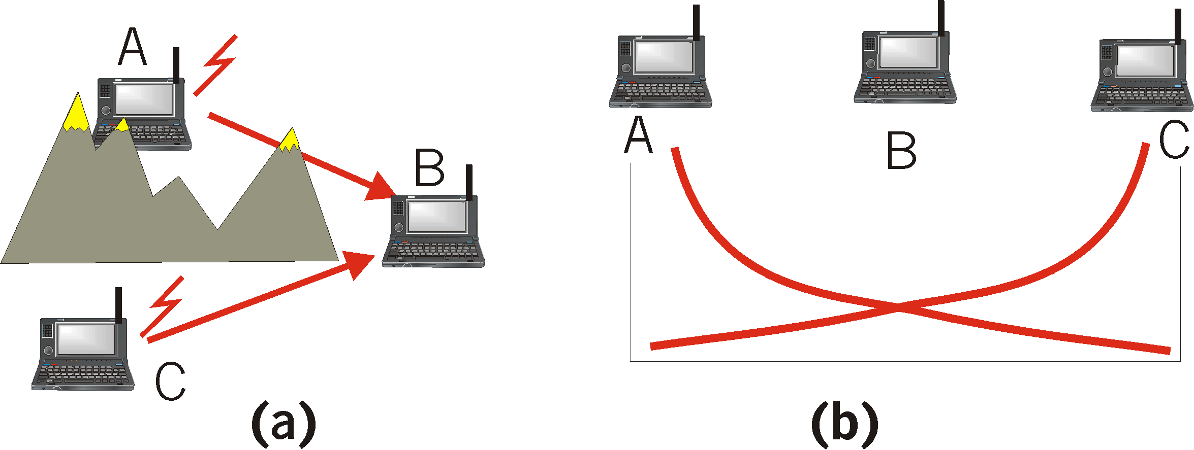
Hidden Terminal effect
(a) A and C cannot hear each other because of obstacles or signal attenuation; so, their packets collide at B
(b) goal: avoid collisions at B
CSMA/CA: CSMA with Collision Avoidance

Slide 47
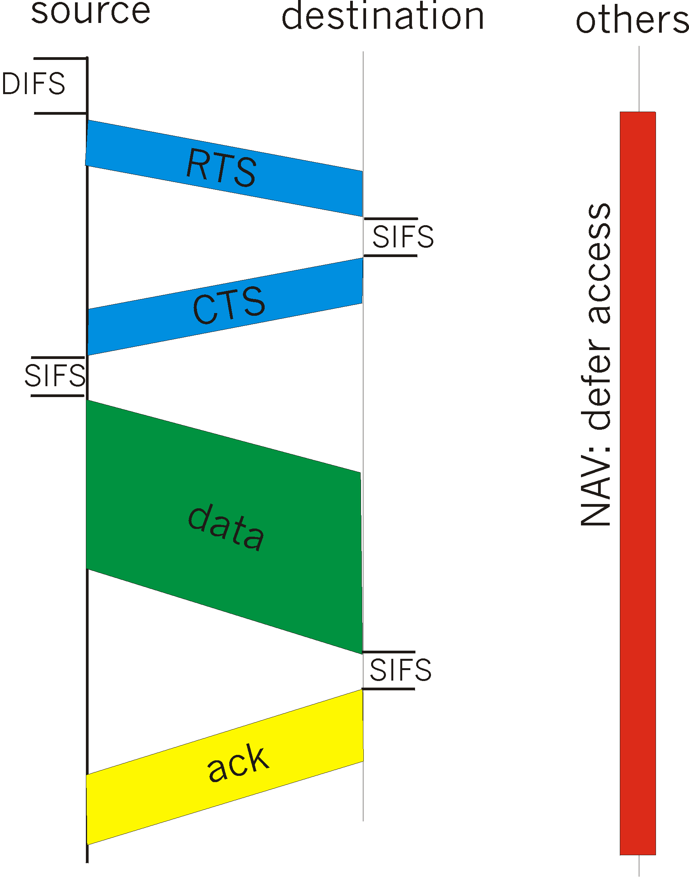
CSMA/CA (Collision Avoidance)
sense channel idle for DISF sec (Distributed Inter Frame Space), send RTS
receiver returns CTS after SIFS (Short Inter Frame Space)
CTS “freezes” stations within range of receiver (but possibly hidden from transmitter); this prevents collisions by hidden station during data
transmit data frame (no Collision Detection)
receiver returns ACK after SIFS (Short Inter Frame Space)
- if channel sensed busy then binary backoff
NAV: Network Allocation
Vector (min time of deferral)
(= min packet size in 802.3)
RTS and CTS are very short: collisions during data phase are thus very unlikely (the end result is similar to Collision Detection)

Slide 48
802.11b security features
ESSID
  Network name, not encrypted
  Rudimentary because the ESS ID is broadcast in beacon frames
Association
  Capability to register a station with a WLAN
WEP (Wired Equivalent Privacy)
  encrypts data using RC4 with 40 to 128-bit shared keys
  Some vendors do in software, others in hardware
  Symmetric Scheme – Same Key For Encrypt/Decrypt
  Intended For:
    Access Control (no WEP key, no access)
    Privacy (encrypt data stream)

Slide 49
Wired Equivalent Privacy
Why Wired Equivalence Privacy?
  Wireless medium has no packet boundaries
    WEP control access to LAN via authentication
  Wireless is an open medium
    Provides link-level security equivalent to a closed medium (note: no end-to-end privacy)
Two Types of Authentication
  Set on Client/Access Points (Same)
  Open (Default): Clear-Text Authentication
    No WEP key required for access
  Shared-Key: Clear-Text Challenge (by AP)
    Must respond with the correct WEP key, or no access
Broken due to bad use of the cipher
[Walker, Berkeley Team, Arbaugh, Fluhrer]

Slide 50
WEP (cont.)
RSA “Fast-Packet Keying”
  Fix Approved By IEEE Committee (2001)
  Generates Unique Encryption Keys For Data Packets
  Reduces Similarities Between Successive Packets
Temporal Key Integrity Protocol (TKIP)
  Approved 2002/01/25, Optional 802.11 Standard
  Helps Defeat Passive Packet Snooping
  Dynamic Keys Defeat Capture of Passive Keys (WEP Hole)
  Some Vendors Starting to Incorporate

Slide 51
Auth: Captive portal
Synopsis:
  Intercepts first HTTP connection
  Redirect to authentication page using SSL
  Does access control based on login / password
Products
  NoCatAuth (freeware)
  Vernier Networks (commercial)
  E-Passport, EZone
Costs:
  Not intrusive nor expensive

Slide 52
Auth: 802.1X
Synopsis:
  authentication before giving access to the network
  Requires a PKI certificate on each client
  Requires a central RADIUS server with EAP
Products:
  CISCO Aironet 350 Series
  Microsoft Windows XP
Costs:
  Deployment is intrusive
  Maintenance is expensive
  Can be a corporate wide solution
Notes:
RADIUS: Steel-Belted RADIUS (FUNK), Microsoft IAS (MS), RAD-P (Interlink), LEAP (Cisco ACS) : NOT A SINGLE ONE IN OPEN SOURCE
card and access point vendors that support 802.1x today include Agere, Cisco, and Enterasys.

Slide 53
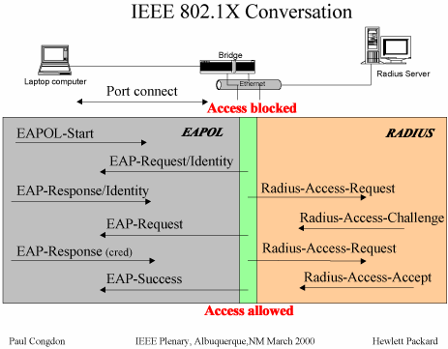
Extensible Authentication Protocol (EAP [RFC 2284])
A port begins in an unauthorized state, which allows EAP traffic only.
Once the Authenticator has received a Supplicant’s request to connect (an EAPOL-Start), the Authenticator replies with an EAP Request Identity message.
The returning Response Identity message is delivered to the Authentication Server.

Slide 54
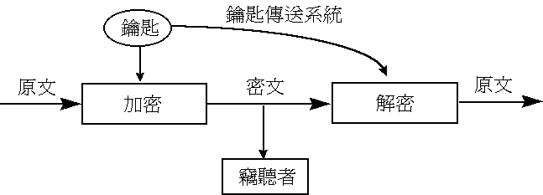
WEP Wired Equivalent Privacy
k is the shared key
Message + checksum(message) = plaintext
  E_{k}(PlainText) = CipherText
  D_{k} ( CipherText) = D_{k} (E_{k}(PlainText) ) = PlainText

Slide 55
WEP crypto function
IV
init. vector
seed
24
WEP
PRNG
key sequence
secret key
64
40
+
cipher text
plaintext
Integrity algorithm
ICV
message
WEP uses RC4 PRNG (Pseudo Random Number Generator)
CRC-32 for Integrity algorithm
IV is renewed for each packet (usually iv++)
key size = (vendor advertised size – 24) bits

Slide 56
WEP Algorithm
Uses RC4 from RSA (AKA stream cipher)
Random Number Generator initialized at the AP
Defenses
  Integrity check (IC) to ensure that the packet has not been modified in transit
  Initialization Vector (IV) – augments shared key to avoid encrypting 2 packets with the same key, produces a different RC4 key for each packet.

Slide 57
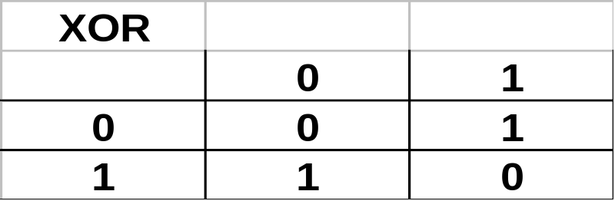
WEP Process
Integrity Check (IC): checksum of message
  Message + checksum(message) = plaintext
Encryption
  Using RC4 and Initialization Vector (IV)
  RC4 generates keystream (PseudoRandom string of bytes as a function of the IV and the key)
XOR (⊕) keystream and plaintext = ciphertext
Send ciphertext and
IV over network

Slide 58
Integrity Check (IC): CRC-32 checksum
Message Authentication using linear checksum : CRC-32
WEP protocol uses integrity checksum field to ensure packets are not modified in transit.
Implemented as a CRC-32 checksum, and is a part of the encrypted payload of the packet.
  Very good for detecting random bit errors, but is it as good for malicious bit errors ?
Can the WEP checksum protect data integrity – one of the main goals of the WEP protocol. Lets see ...

Slide 59
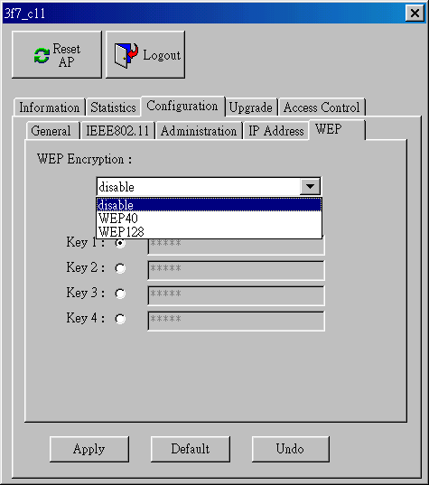
WEP enable (on Access Point)

Slide 60
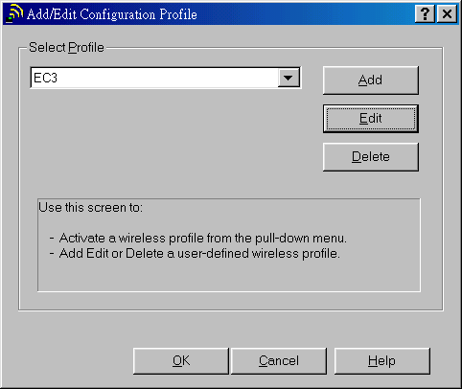
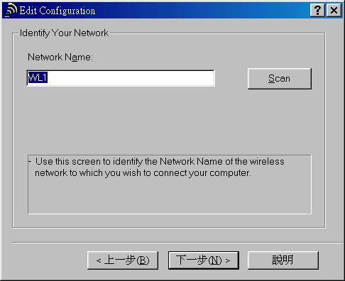
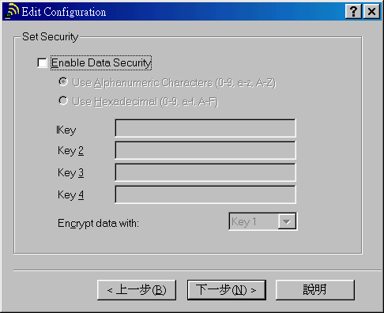
WEP enable (on PC card)

Slide 61
WEP at the receiver
Sender and receiver use same key
  Sender encrypts
Receiver decrypts
  Sender XOR keystream and plaintext to get ciphertext
  Receiver XOR ciphertext with same key to get plaintext
  … RC4(x) ⊕ keystream = x

Slide 62
WEP Encryption / Decryption
Encryption: (by sender)
Message
CRC-32
xor
Keystream = RC4(v,k)
Decryption: (by receiver)
v
Cipher text
v
Cipher text
Keystream = RC4(v,k)
xor
Message
CRC-32

Slide 63
Secret Shared Key Authentication
Frame Cont | Dura-tion | Dest-addr | Sour-addr | BSSID | Seq # | Frame Body | FCS
Algo No | Seq No | Status Code | Elem ID | Len | Challenge Text
Authentication Management Frame
Initiator send authentication request management frame.
Responder sends Challenge text to Initiator.
Initiator picks a Initialization Vector (IV), v encrypts challenge text using v, k and sends back to responder.
Responder decrypts the received frame and checks if the challenge text matches that sent in first message. SUCCESS!!!

Slide 64
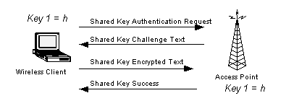
Initiator Responder
Authentication Request (Status)
Seq #1
Authentication Challenge (Frame in Plain text)
Seq #2
Authentication Response (Frame in cipher text)
Seq #3
Authentication Result (Status message SUCCESS/Failure)
Seq #4

Slide 65
Authentication Spoofing
Both plaintext challenge and encrypted challenge are sent over the wireless channel during authentication.
Attacker can thus derive the RC4 keystream.
Use this keystream to encrypt its own challenge (which is of same length)
Serious problem becoz same shared key is used by all the mobile users.

Slide 66
Problems with WEP
IC is a 32 bit checksum and is part of the encrypted payload
  It is possible to compute the bit differences between the 2 ICs based on the bit differences of the messages
  An attacker can then flip bits in both to make a message appear to be valid
IC: Integrity Check

Slide 67
Problems with WEP (2)
IV is a 24 bit field sent in the clear text portion of the message
  24 bits guarantees eventual reuse of keys
  2²⁴ possibilities (16,777,216)
  Max data
  A busy access point will reuse keys after a couple of days
IV: Initialization Vector

Slide 68
Problems with WEP (3)
WEP is a per packet encryption method
  This allows data streams to be reconstructed from a response to a known data packet
  For ex. DHCP, ICMP, RTS/CTS
  In addition to decrypting the streams, this allows for the attack known as packet spoofing.

Slide 69
Problem with RC4
If 2 ciphertexts are known, it is possible to obtain the XOR of the plaintexts
Knowledge of the XOR can enable statistical attacks to recover plaintext
Once one of the two plaintexts is known, it is simple to recover others
RC4(x) ⊕ X ⊕ Y = RC4(y)

Slide 70
Attacks against WEP
50% chance of a collision exists already after only 4823 packets!!!
Pattern recognition can disentangle the XOR’d recovered plaintext.
Recovered ICV can tell you when you’ve disentangled plaintext correctly.
After only a few hours of observation, you can recover all 2²⁴ key streams.

Slide 71

Attacks against WEP (cont)
Passive Attack to Decrypt Traffic
Table-based Attack

Slide 72
How to Read WEP Encrypted Traffic
Ways to accelerate the process:
Send spam into the network: no pattern recognition required!
  Get the victim to send e-mail to you
  The AP creates the plaintext for you!
Decrypt packets from one Station to another via an Access Point
If you know the plaintext on one leg of the journey, you can
recover the key stream immediately on the other
–Etc., etc., etc.
http://www.cs.umd.edu/~waa/attack/v3dcmnt.htm

Slide 73
Papers on WLAN Security
University of California, Berkeley
University of Maryland
Scott Fluhrer, Itsik Mantin, and Adi Shamir
University of Maryland
Feb. 2001 April 2001 July 2001 February 2002
Focuses on authentication; identifies flaws in one vendor’s proprietary scheme
Flawed paper talking about
Possible problems with 802.1x
Focuses on static WEP; discusses need for key management
Focuses on inherent weaknesses in RC4; describes pragmatic attacks against RC4/WEP
* “In practice, most installations use a single key that is shared between all mobile stations and access points. More sophisticated key management techniques can be used to help defend from the attacks we describe…”
− University of California, Berkeley report on WEP security, http://www.isaac.cs.berkeley.edu/isaac/wep-faq.html
Notes:
April paper talks about Lucent dynamic key solution, Maryland also deployed 300 Cisco AP
Weaknesses in the Key Scheduling Algorithm of RC4
Authors are experts on cryptology
Paper describes general weaknesses with RC4 and describes how to mount attacks on RC4-based WEP keys
Attack is implemented in AirSnort tool
Shamir he is the S RSA
Fluhrer he is an Enginner for Cisco

Slide 74
'Off-the-shelf' hack breaks wireless encryption
http://www.cnn.com/2001/TECH/ptech/08/10/wireless.hack/index.html
(CNN) -- A group of researchers from Rice University and AT&T Labs have used off-the-shelf methods to carry out an attack on a known wireless encryption flaw -- to prove that it "could work in the real world."
The researchers from Rice University in Houston, Texas, and AT&T performed their recent attack after reading a detailed and highly scientific description of the vulnerability written several weeks ago by Scott Fluhrer from Cisco Systems, and Itsik Mantin and Adi Shamir from The Weizmann Institute of Science in Israel.

Slide 75


Hackers poised to land at wireless AirPort
http://zdnet.com.com/2102-11-527906.html
By Jared Sandberg, The Wall Street Journal Online
http://airsnort.shmoo.com/
AirSnort operates by passively monitoring transmissions, computing the encryption key when enough packets have been gathered.
http://sourceforge.net/projects/wepcrack
WEPCrack is a tool that cracks 802.11 WEP encryption keys using the latest discovered weakness of RC4 key scheduling.
http://www.netstumbler.com/

Slide 76
AirSnort “Weak IV” Attack
Initialization vector (IV) is 24-bit field that changes with each packet
RC4 Key Scheduling Algorithm creates IV from base key
Flaw in WEP implementation of RC4 allows creation of “weak” IVs that give insight into base key
More packets = more weak IVs = better chance to determine base key
To break key, hacker needs 100,000-1,000,000 packets
dest addr
src addr
IV
encrypted data
ICV
WEP frame
Notes:
When they see two FF together they know it can be broken. Lucent tries to avoid any IV with FF in the newer version of code. Since we made our own chip set we were able to change randomize the IV.

Slide 77
Security improvements (2nd Gen)
WEP2
  Increases size of IV to 128 bits
  Use of Kerberos for authentication within IEEE 802.1X
Be device independent => be tied to the user
Have changing WEP keys
  WEP keys could be generated dynamically upon user authentication

Slide 78
Cisco Aironet Security Solution
Provides Dynamic WEP to
Address Researchers' Concerns
Many WLAN deployments use static WEP keys that significantly compromise security, as many users in a given WLAN share the same key.
With the Aironet Software Release 11.0 and ACS 2.6, Cisco offers centrally managed, dynamic per user, per session WEP that addresses several of the concerns that the researchers refer to in their paper.
The Cisco Aironet wireless security solution augments 802.11b WEP by creating a per-user, per-session, dynamic WEP key tied to the network logon, thereby addressing the limitations of static WEP keys while providing a deployment that is hassle-free for administrators.
URL: http://www.cisco.com/warp/public/cc/pd/witc/ao350ap/prodlit/1281_pp.htm
Airsnort ( http://airsnort.sourceforge.net) and
WEPCrack (http://wepcrack.sourceforge.net) are two utilities that can be used to recover WEP keys.
Notes:
Move to end of presentation.

Slide 79

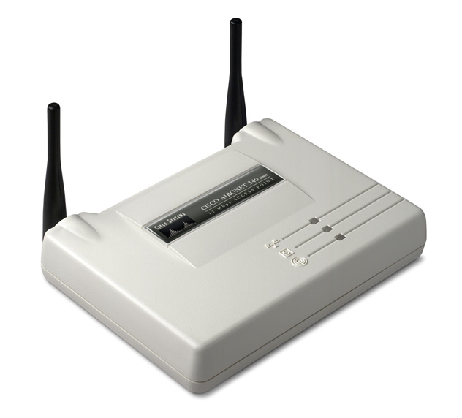


Dynamic WEP Key Management
Fast Ethernet
RADIUS
Laptop computer
Access Blocked
802.11 Associate
802.11
RADIUS
EAPOL-Start
EAPOW
EAP-Request/Identity
EAP-Response/Identity
Radius-Access-Request
EAP-Request
Radius-Access-Challenge
EAP-Response (Credential)
Radius-Access-Request
EAP-Success
Radius-Access-Accept
EAPW-Key (WEP)
Access Allowed

Slide 80
References
http://www.personaltelco.net/index.cgi/WepCrack
http://sourceforge.net/projects/wepcrack
http://www.cs.rice.edu/~astubble/wep/wep_attack.pdf
Airsnort : http://airsnort.sourceforge.net/
http://airsnort.shmoo.com/
http://www.wlana.org/learn/80211.htm
http://www.cs.rice.edu/~astubble/wep/
http://www.isp-planet.com/technology/2001/wep.html
http://www.isp-planet.com/fixed_wireless/technology/2001/better_wep.html
http://www.isp-planet.com/fixed_wireless/technology/2001/wlan_primer_part2.html
http://rr.sans.org/wireless/equiv.php
http://rr.sans.org/wireless/wireless_sec.php

Slide 81
References (2)
http://www.cs.tamu.edu/course-info/cpsc463/PPT/
http://www.newwaveinstruments.com/resources/
http://vip.poly.edu/seminar/
http://www.ietf.org/rfc/rfc2284.txt
Nikita Borisov , Ian Goldberg , David Wagner, “Intercepting mobile communications,” The seventh annual international conference on Mobile computing and networking, 2001 July 2001
N. Golmie, R. E. Van Dyck, and A. Soltanian, “Interference of bluetooth and IEEE 802.11: simulation modeling and performance evaluation,“ Proceedings of the 4th ACM international workshop on Modeling, analysis and simulation of wireless and mobile systems, 2001, Rome, Italy

Slide 82
References (3)
http://www.ieee802.org/11/
http://standards.ieee.org/getieee802/
http://www.wi-fi.org
http://www.homerf.org
http://www.hiperlan2.com
http://www.commsdesign.com
http://www.80211-planet.com
http://www.cs.umd.edu/~waa/attack/v3dcmnt.htm
http://www.dgt.gov.tw
http://www.wirelesscorp.net/802.11_HACK.htm

Slide 83
References (4)
Cisco Aironet:
http://www.cisco.com/warp/public/cc/pd/witc/ao350ap/prodlit/1281_pp.htm
http://www.csie.nctu.edu.tw/~tsaiwn/802.11/

Slide 84

Wireless LAN & IEEE 802.11
謝謝捧場
tsaiwn@csie.nctu.edu.tw
蔡文能

